Slide 1
Education Expenditure in Relation to Performance
Analysis of how regional expenditures affect the performances of enrolled students.
TEAM MARS
Matt, Aritra, Roman, Sean

Slide 2
Question 1
How does K-12 financing in different states and regions affect the overall performance of the students enrolled? Regions split into Northeast, Midwest, South, West.

Slide 3
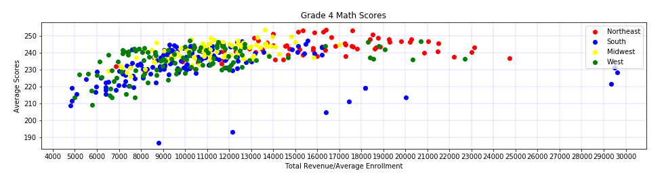
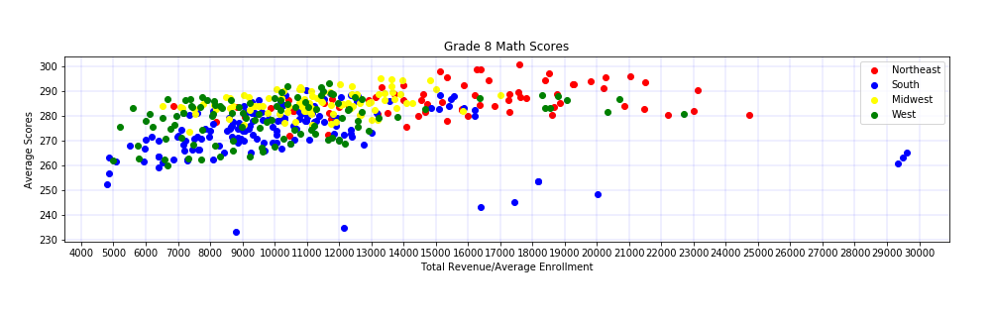
Math Score Analysis

Slide 4
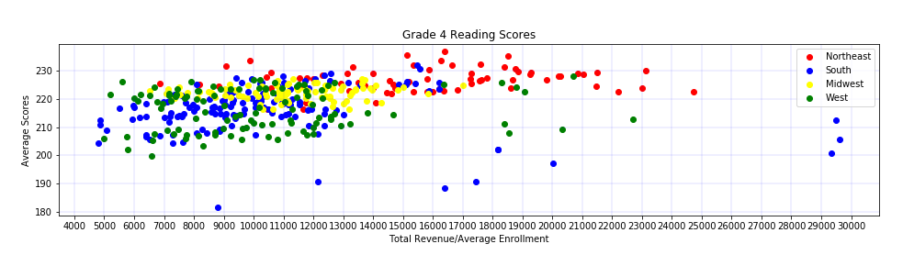
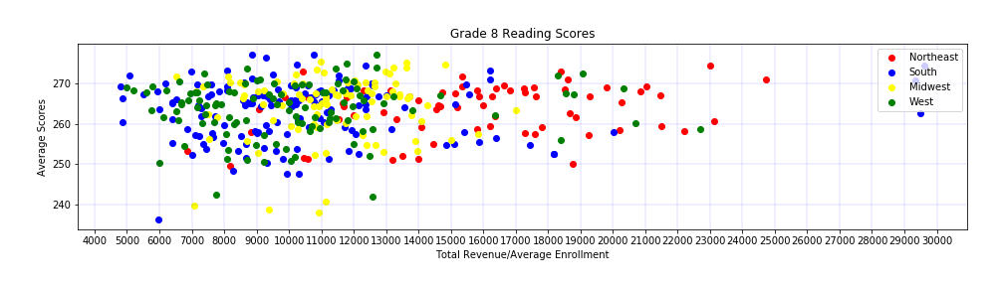
Reading Score Analysis

Slide 5
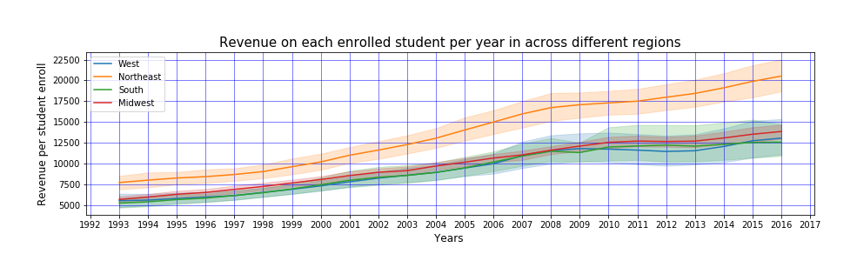
Year by Year Analysis
Expenditure per students have significantly risen in each region since 1993.

Slide 6
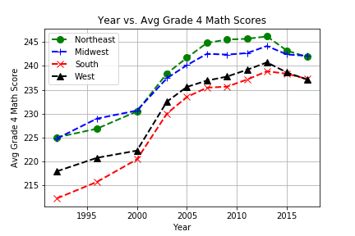
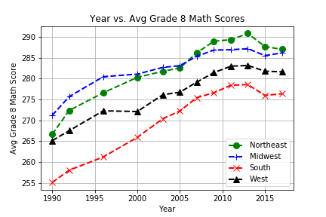
Since 1993 Regional Math Scores have increased in correlation with the increase in expenditures per region.

Slide 7
Question 1 Conclusion
There appears to be a direct correlation between increased spending and increase in performance in math. However, there is no correlation between spending and performance in reading.
There does not seem to be a correlation between regions that spend more and those regions having higher performances in math.

Slide 8
Question 2
Year by year analysis of how regional revenues affected the enrollment statistics for those regions?

Slide 9
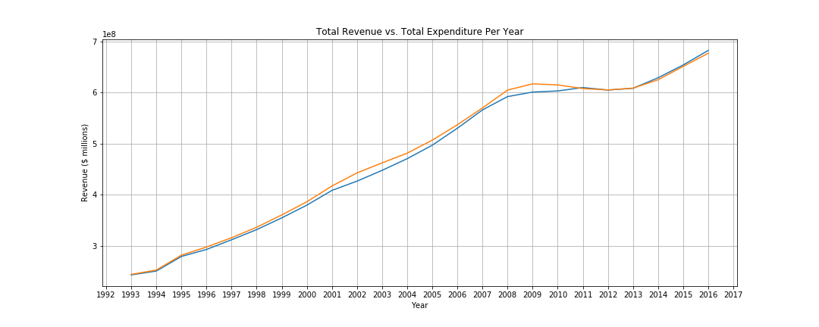
Analysis of Question 2
Both revenues and expenditures in education nationwide have significantly increased.

Slide 10
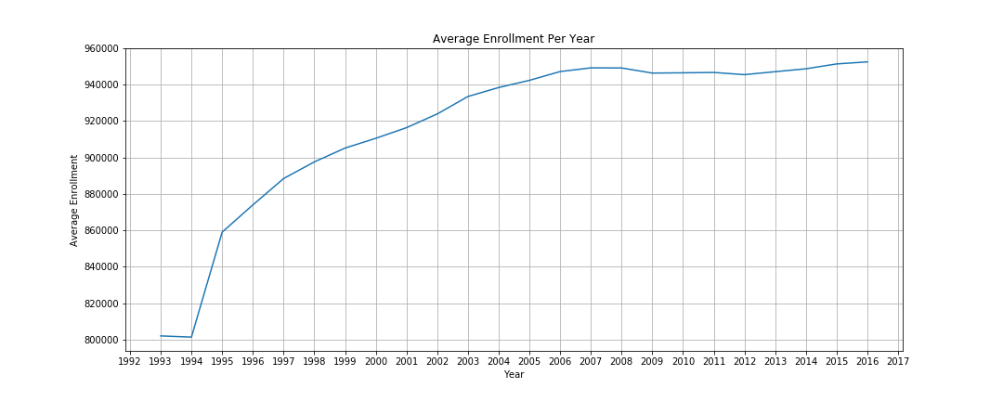
Analysis of Question 2
Average enrollment has drastically increased over the past 14 years.

Slide 11
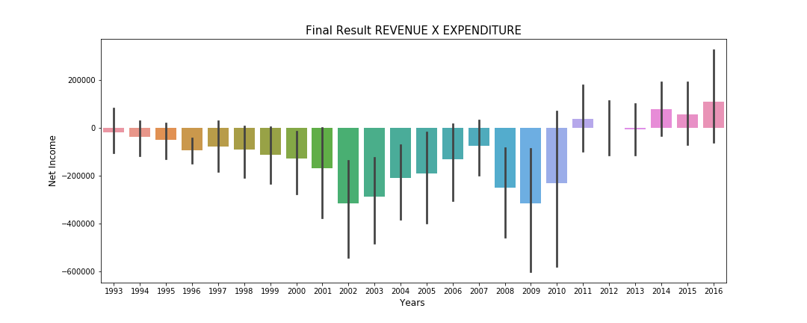
Analysis of Question 2
Average expenditure per Region has been greater than revenue until 2010.

Slide 12
Question 2 Conclusion
Initial increase in expenditures will initiate a more drastic increase in enrollment, however through the years even though regions have continued to increase expenditures the increase in enrollment is not as drastic and levels out to a steady in increase.
For many years there was a clear goal to budget more funding for education versus other programs or resources.

Slide 13
Question 3
How does each Region’s performance become affected by the expenditure of each Region?

Slide 14
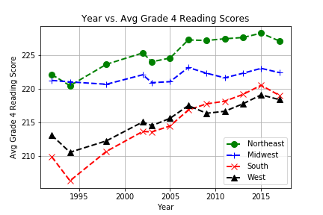
Analysis of Question 3
Overall in since 1993 all regions have increased their Grade 4 Math and Reading performances.

Slide 15
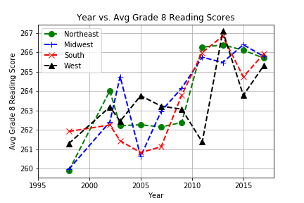
Analysis of Question 3
Average Grade 8 Math and Reading Scores have significantly increased for all Regions.

Slide 16
Question 3 Conclusion
Math scores for both 4th and 8th grades directly correlate with the expenditure between regions and as the expenditures increase the overall math performance increases.
Increase in expenditure does not necessarily mean higher reading performance even though as a whole through the past 16 years all reading scores across regions are higher just like regional expenditures.
The lack of correlation between expenditures signifies that there could be outside factors increasing reading scores, such as, increased exposure to K-12 education.

Slide 17
Question 4
Education revenue per region over the years.

Slide 18
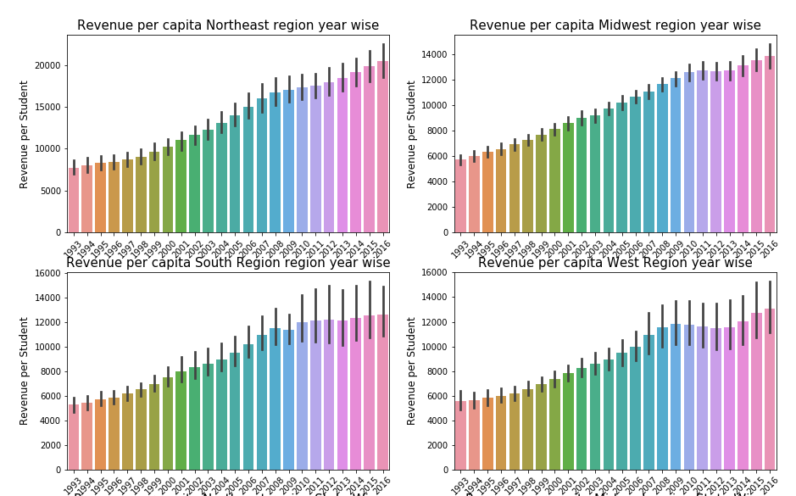
Analysis of Question 4
Overall since 1993 revenue per capita has increased in all regions.

Slide 19
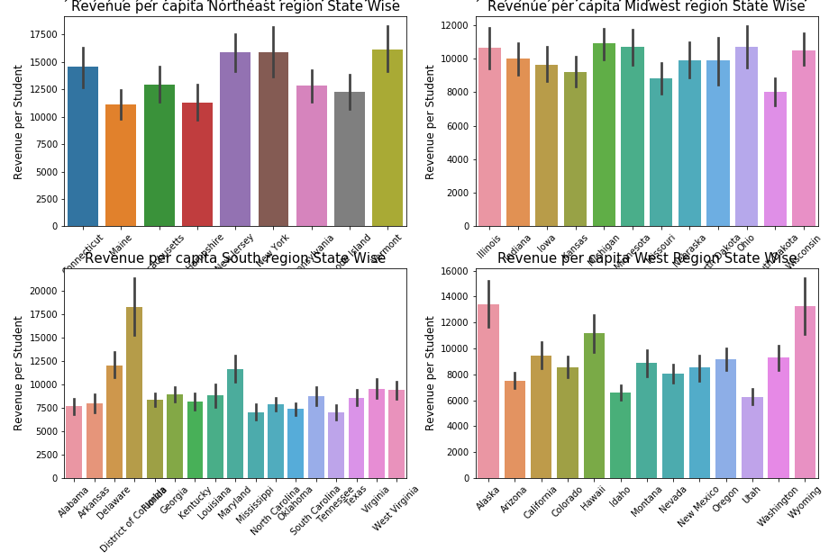
Analysis of Question 4
State Composition of Per Capita Revenues per Region.

Slide 20
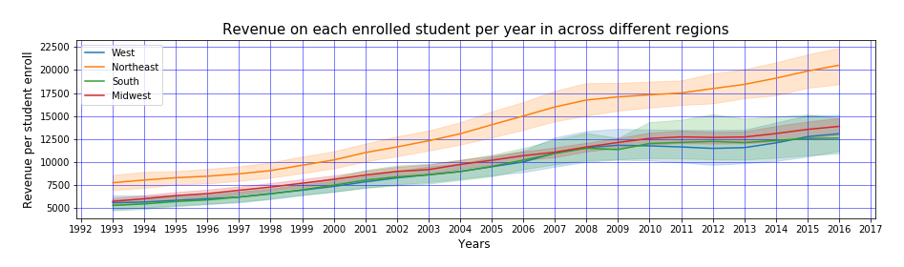
Analysis of Question 4
State Composition of Per Capita Revenues per Region.

Slide 21
Question 4 Conclusion
Overall revenue per capita rises through the years but there are dips in the West region 2011-2012 and in the Midwest Region during the same time that show there are extenuating factors that could contribute to decreases in the revenue per capita.
For example, people moving from certain states to other states, economic crises and other situations that bring about decreases other than choosing to decrease revenue.
Northeast in both revenue and expenditure are significantly higher than all other regions which can be attributed to cost of living, cost education, salaries and weather.

Slide 22
Hypothesis
As a whole more funding from Federal, State, and Local generally transitions into higher test scores.
As eras change then investment trends in education will reflect the financial outlook of the state.

Slide 23
Final Analysis
Higher expenditures means higher test scores.
Since 1992 it appears that nationwide, people are constantly concerned with spending on education and consistently are seeking to spend more and more on education and the importance of education is reflected by the expenditure rise. Education is significantly a more important issue than before 1992.
The Analysis of Variance Test (ANOVA) was performed on the Math and Reading Scores for both 4th grade and 8th grade across the regions. It is observed that the p-values that were computed from the ANOVA test for Math Grade 4 and Grade 8 comes out to be 6.76 e -05 and 2.07 e -05 where as the Reading Grade 4 and Grade 8 p-value scores are 0.0001 and 0.57 across regions. This demonstrates that the Reading scores have statistically significant differences among the regions, whereas the Math scores do not portray statistical significant difference.

